Slide 1
Python programming
unit 3a – recursion, stdin

Slide 2
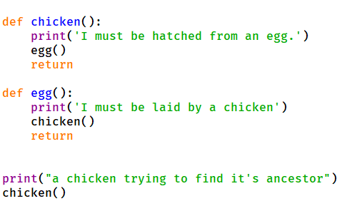
What is recursion
Function call loop
When a function call itself
When a function call other function, but other function finally calls back to this function again
It can be infinite and never return if the loop cannot break

Slide 3
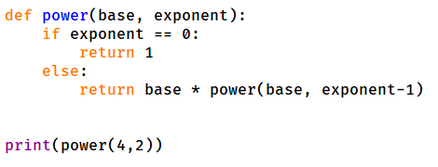
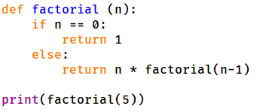
What is recursion
In the Function call loop
Each time the conidiation should have slight difference
When the condition reaches certain value, then it does not need continue to call, can find the result and return

Slide 4
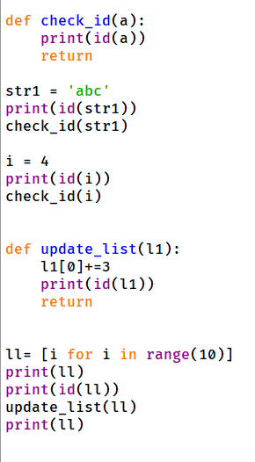
How value passed in function call
Pass by ref:
In python parameter passed like assignment, one more name associated with the data value which is the argument name inside the function.

Slide 5
What is stdin and how to use it
Stdin is one input device, for human to send information into computer
Use input() function in python. (a build-in function, no need import anything)
Use sys.stdin device. (need import sys)
User fileinput module. (need import fileinput)
fileinput.input(), fileinput.close(), and for loop to read line by line.

